Slide 1
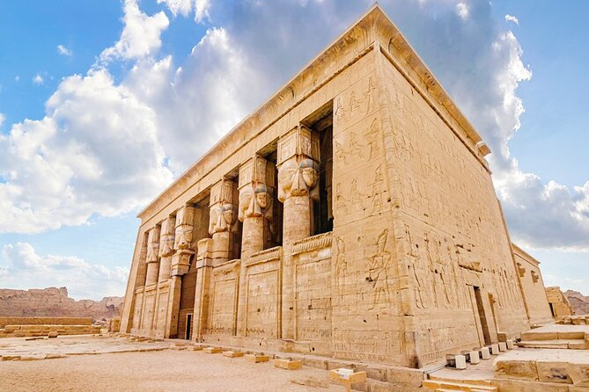
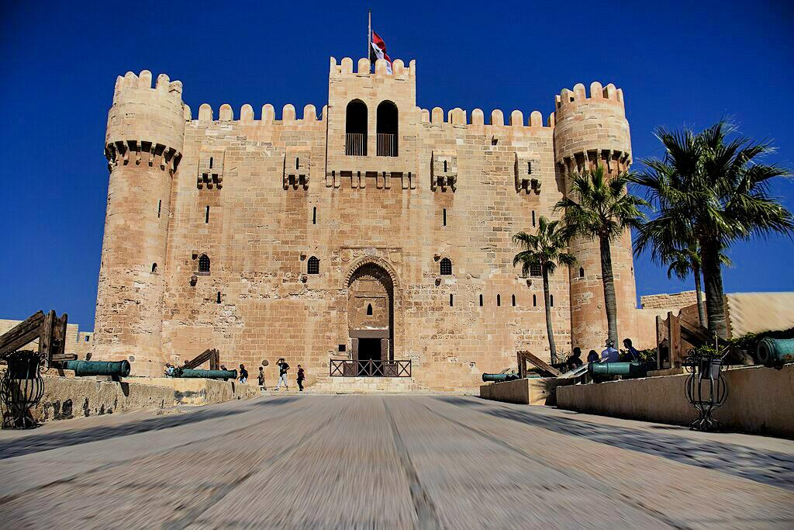
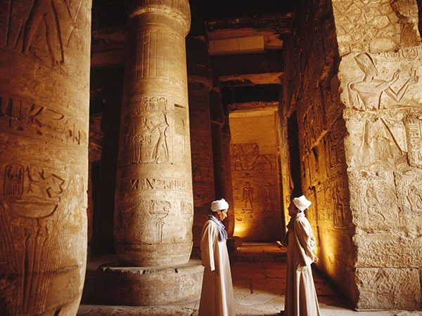



Explore the Timeless Wonders of:
Egypt
February 2025
PYRAMIDS AND PHARAOHS IN THE GREAT CIRCUIT

Slide 2
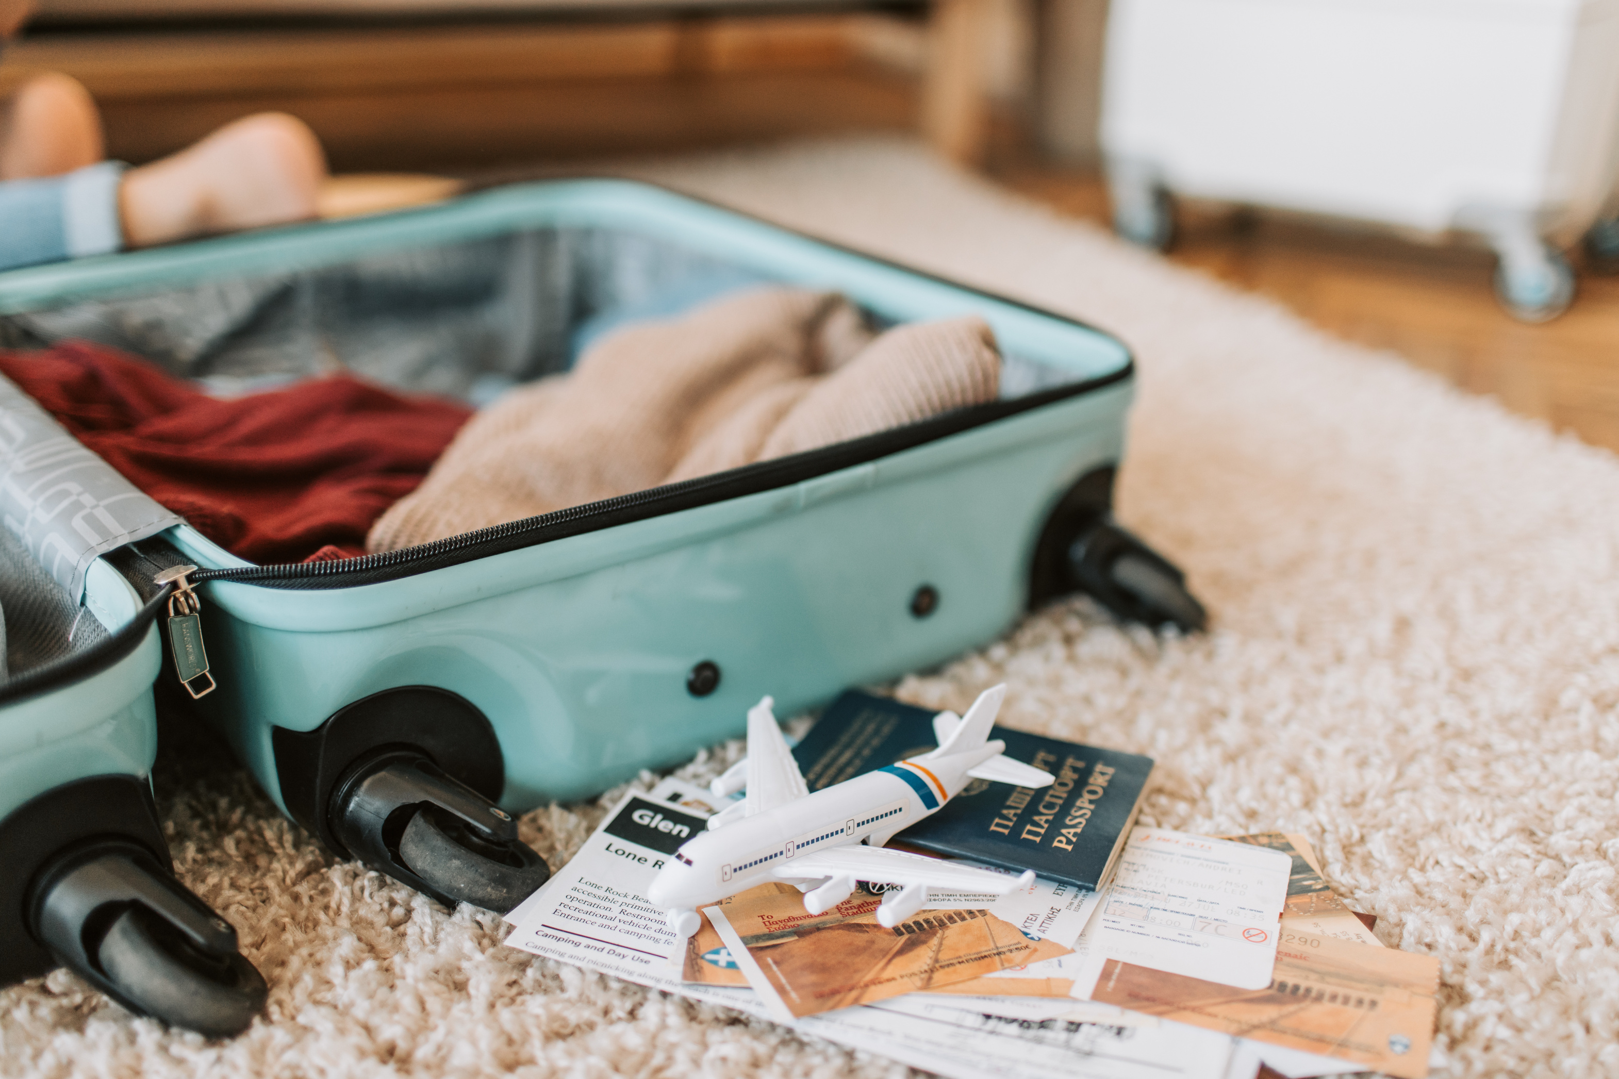


Day 1:
Arrival in Hurghada
  Departure:
From domestic airport on a direct flight to Egypt.
  Arrival:
Transfer to the hotel for check-in.
  Free Time:
Relax and enjoy the hotel facilities.

Slide 3
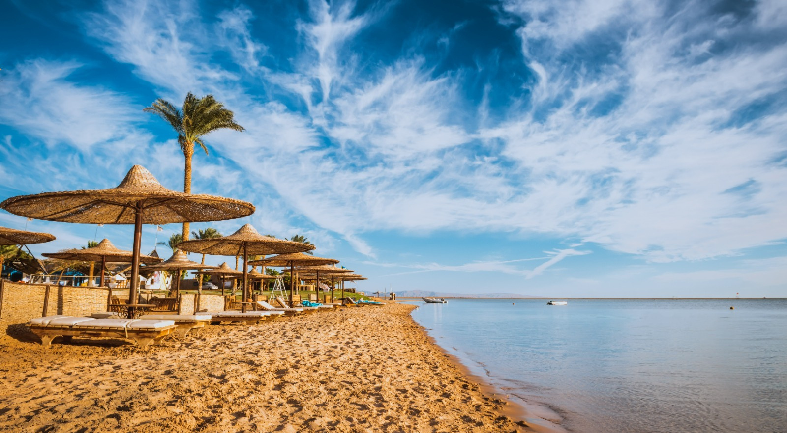
Day 2: Hurghada
  Free Day:
Explore Hurghada or
relax by the Red Sea.
  Meeting:
Attend an informational meeting with your tour representative.

Slide 4


  Early Morning Departure:
Travel from Hurghada to Dendera and Abydos with a guide.
Dendera Highlights:
  Temple of Hathor:
The best-preserved temple in Egypt.
  Intricate Carvings:
Learn about the "Put-Sar" ceremony and ancient astronomy.
  Mysteries of Horus' Eye:
Discover ancient Egyptian civilizations.
Day 3:
Dendera
and Abydos
Abydos Highlights:
  Explore Abydos:
One of Egypt's most significant archaeological sites.
  Temple of Seti I:
Renowned for its unique architecture and historical importance.
  Royal Cemetery:
Home to the earliest pharaohs.
  Evening:
Transfer to Luxor, check in to your hotel, and enjoy free time.

Slide 5
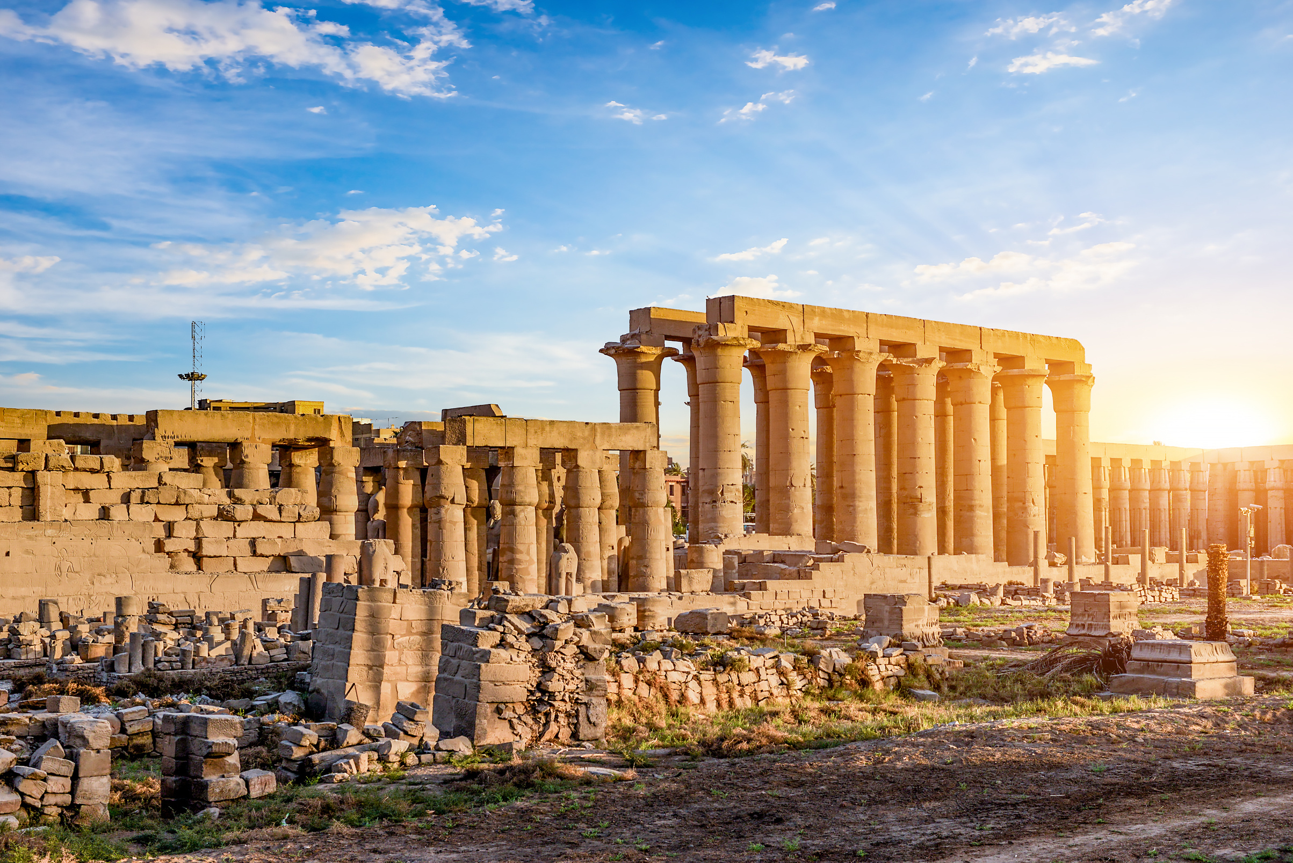
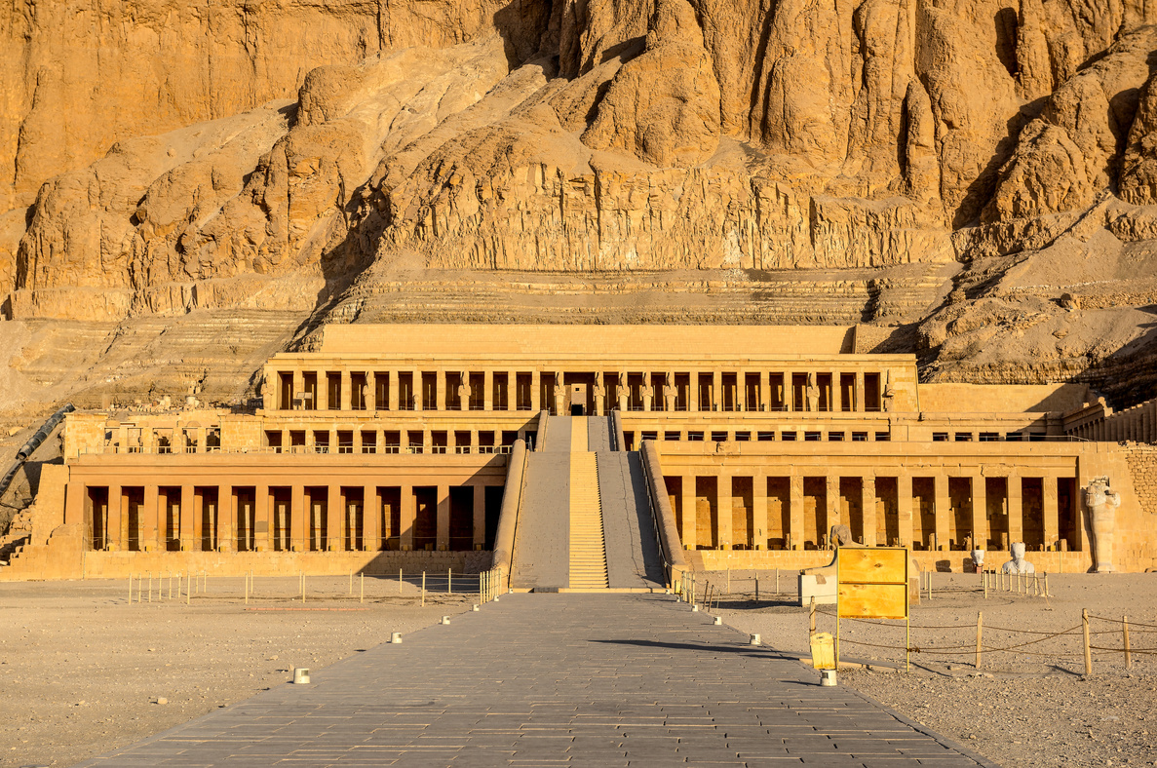
Morning Guided Tour:
  Memnon Colossi:
Two massive statues of Pharaoh Amenhotep III.
  Valley of the Kings:
Discover the tombs of New Kingdom pharaohs, including Tutankhamun’s.
  Temple of Hatshepsut:
A stunning mortuary temple honoring Queen Hatshepsut.
Afternoon Visits:
  Karnak Temple:
The largest temple complex in Egypt, built over 1,500 years.
  Luxor Temple:
A majestic sanctuary dating back to 1400 BC, once a Roman fortress.
  Special Experience:
Take a scenic Nile River cruise aboard a traditional felucca.
  Evening:
Transfer to Luxor Airport for a flight to Cairo. Check in to your hotel upon arrival.
Day 4:
Luxor

Slide 6

Day 5: Alexandria
  Kom El Shoqafa Catacombs:
An extraordinary Greco-Roman burial site discovered by chance.
  Bibliotheca Alexandrina:
A modern revival of the ancient Great Library of Alexandria.
  Citadel of Qaitbay:
A 15th-century fortress built on the site of the ancient Lighthouse of Alexandria, one of the Seven Wonders of the Ancient World.
Evening: Return to Cairo for an overnight stay.
Morning Departure to Alexandria

Slide 7
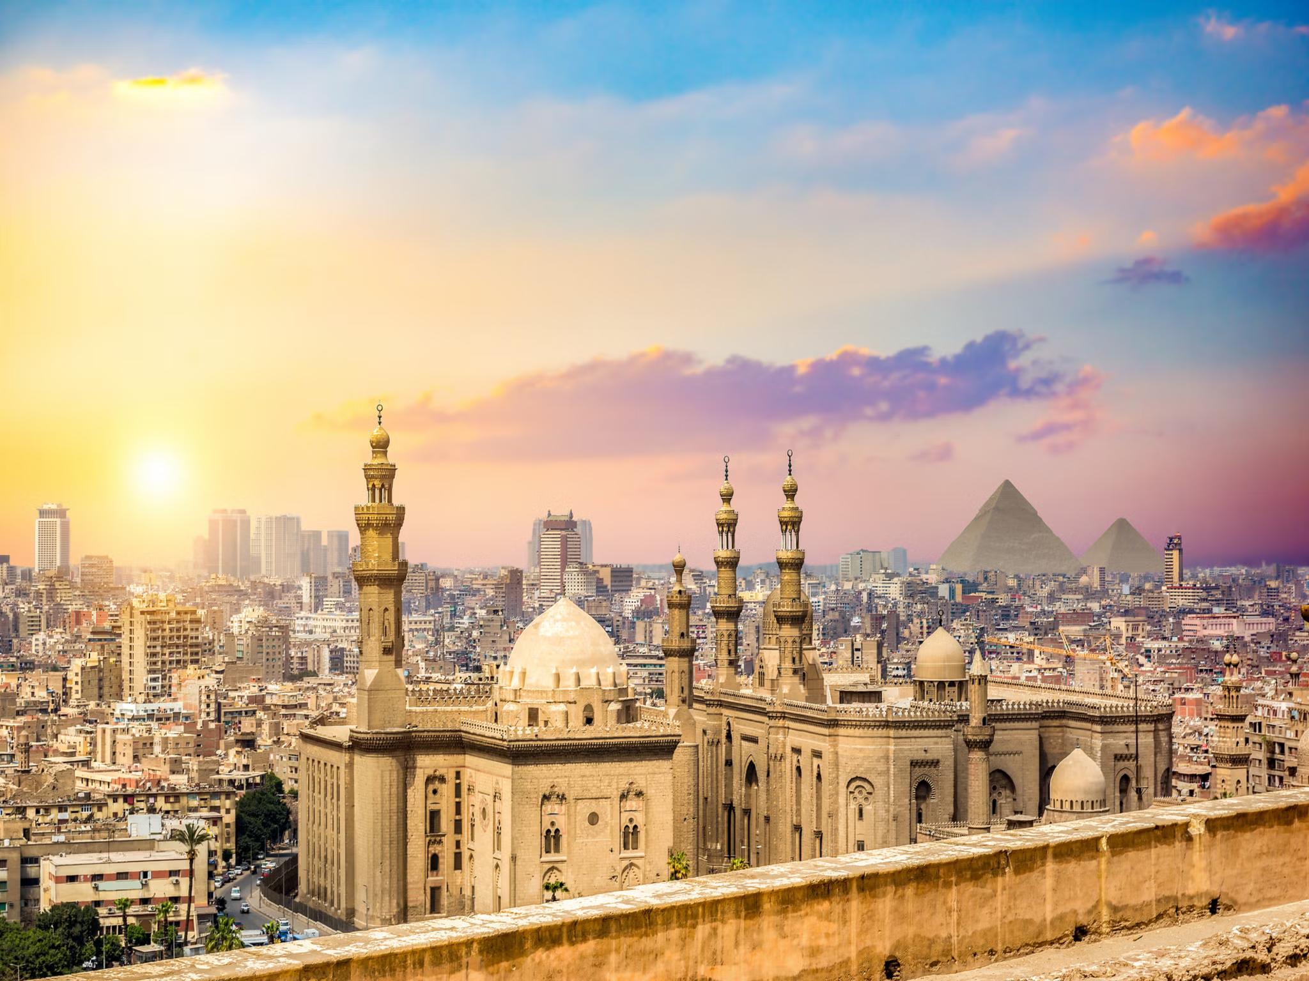
  Morning Guided Tour of Cairo:
Grand Egyptian Museum: Home to 10,000 artifacts, including treasures of Tutankhamun.
  Pyramids of Giza:
One of the Seven Wonders of the Ancient World.
  Great Sphinx:
A symbol of ancient Egypt’s grandeur.
  Afternoon Excursion to Saqqara:
  Step Pyramid:
The world’s oldest pyramid, located in the Saqqara necropolis.
  Dahshur:
Home to the Red Pyramid and the Bent Pyramid.
  Evening:
Transfer to Cairo Airport for a flight back to Hurghada. Overnight stay in Hurghada.
Day 6:
Cairo

Slide 8
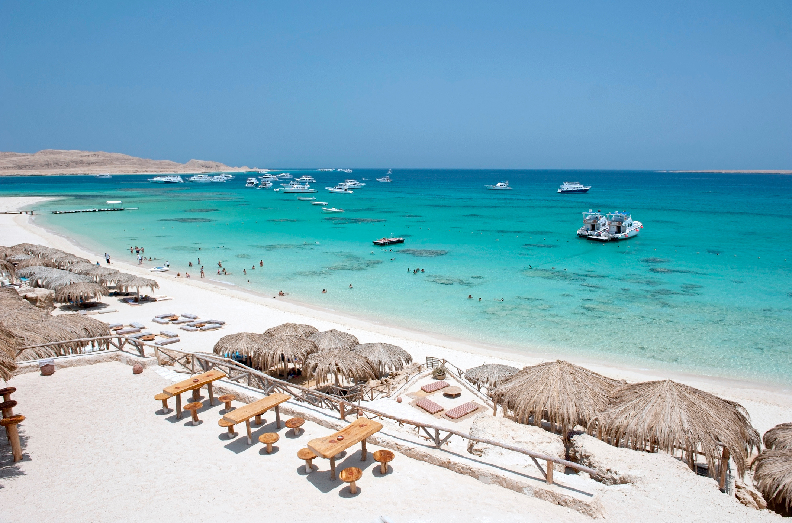
Day 7: Hurghada
  Free Day:
Relax or explore Hurghada at your leisure.

Slide 9

Day 8: Departure
  Departure:
After Breakfast:Transfer to Hurghada Airport for a direct flight to your homeland.

Slide 10
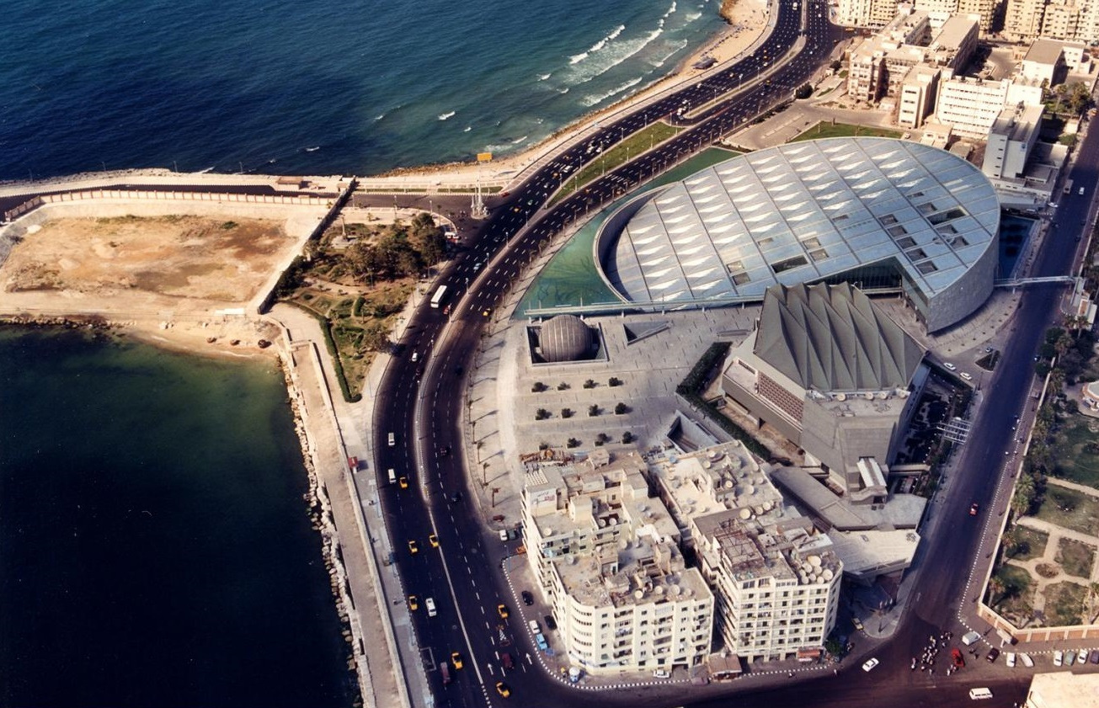
Inclusions
  Accommodation in Hurghada, Luxor, and Cairo.
  Guided tours with an Egyptologist.
  Entry fees to all mentioned monuments.
  Meals as specified (lunch included; drinks extra).
  Domestic flights within Egypt.

Slide 11

Exclusions
  Drinks during meals.
  Entry to the interior chambers of pyramids (optional).

Slide 12

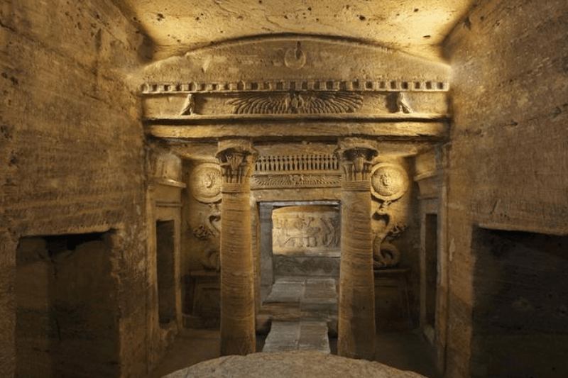

Testimonial
  "Our Egypt tour was simply amazing! The guides were knowledgeable, and the itinerary was perfectly planned. Visiting the Pyramids of Giza and cruising the Nile were experiences we'll never forget. Highly recommend!"
"Thank you for an incredible journey through Egypt! The accommodations were great, and the historical sites were breathtaking. We felt well taken care of every step of the way.
  A trip of a lifetime!"

