Slide 1
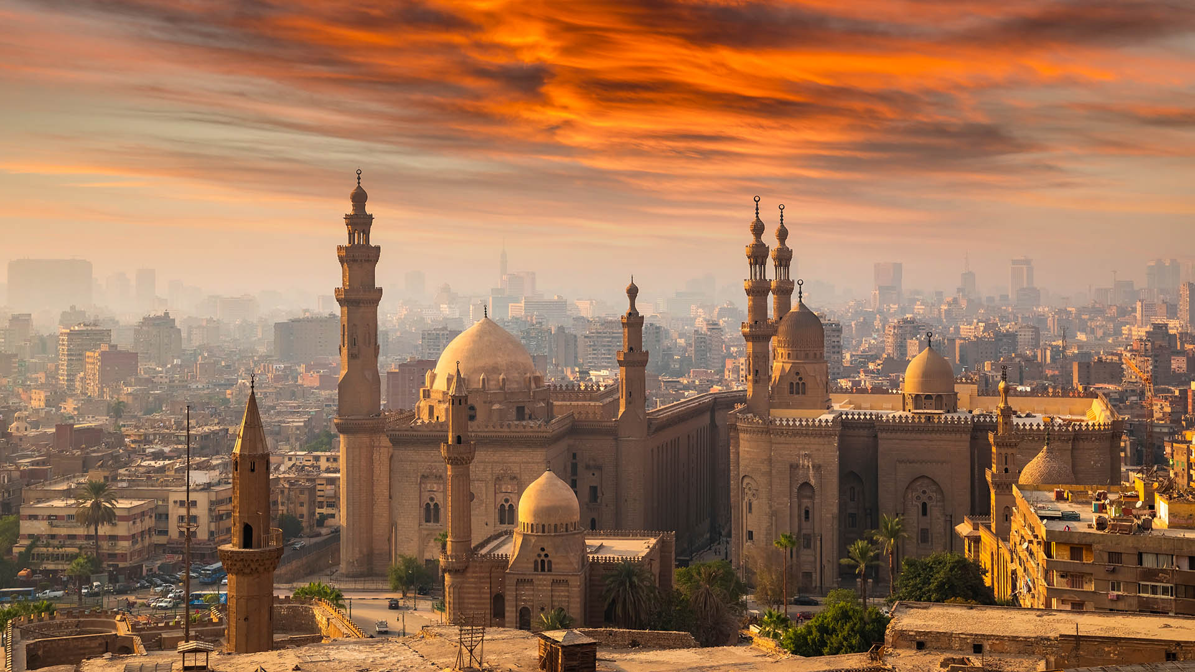
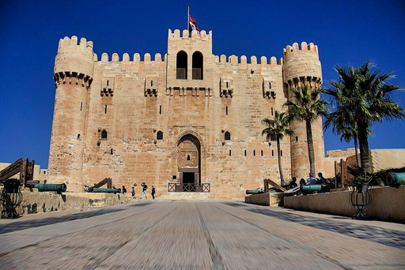
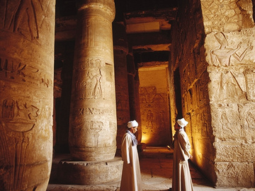





Explore the Timeless Wonders of:
CAIRO
February 2025
"CITY OF A THOUSAND MINARETS"

Slide 2
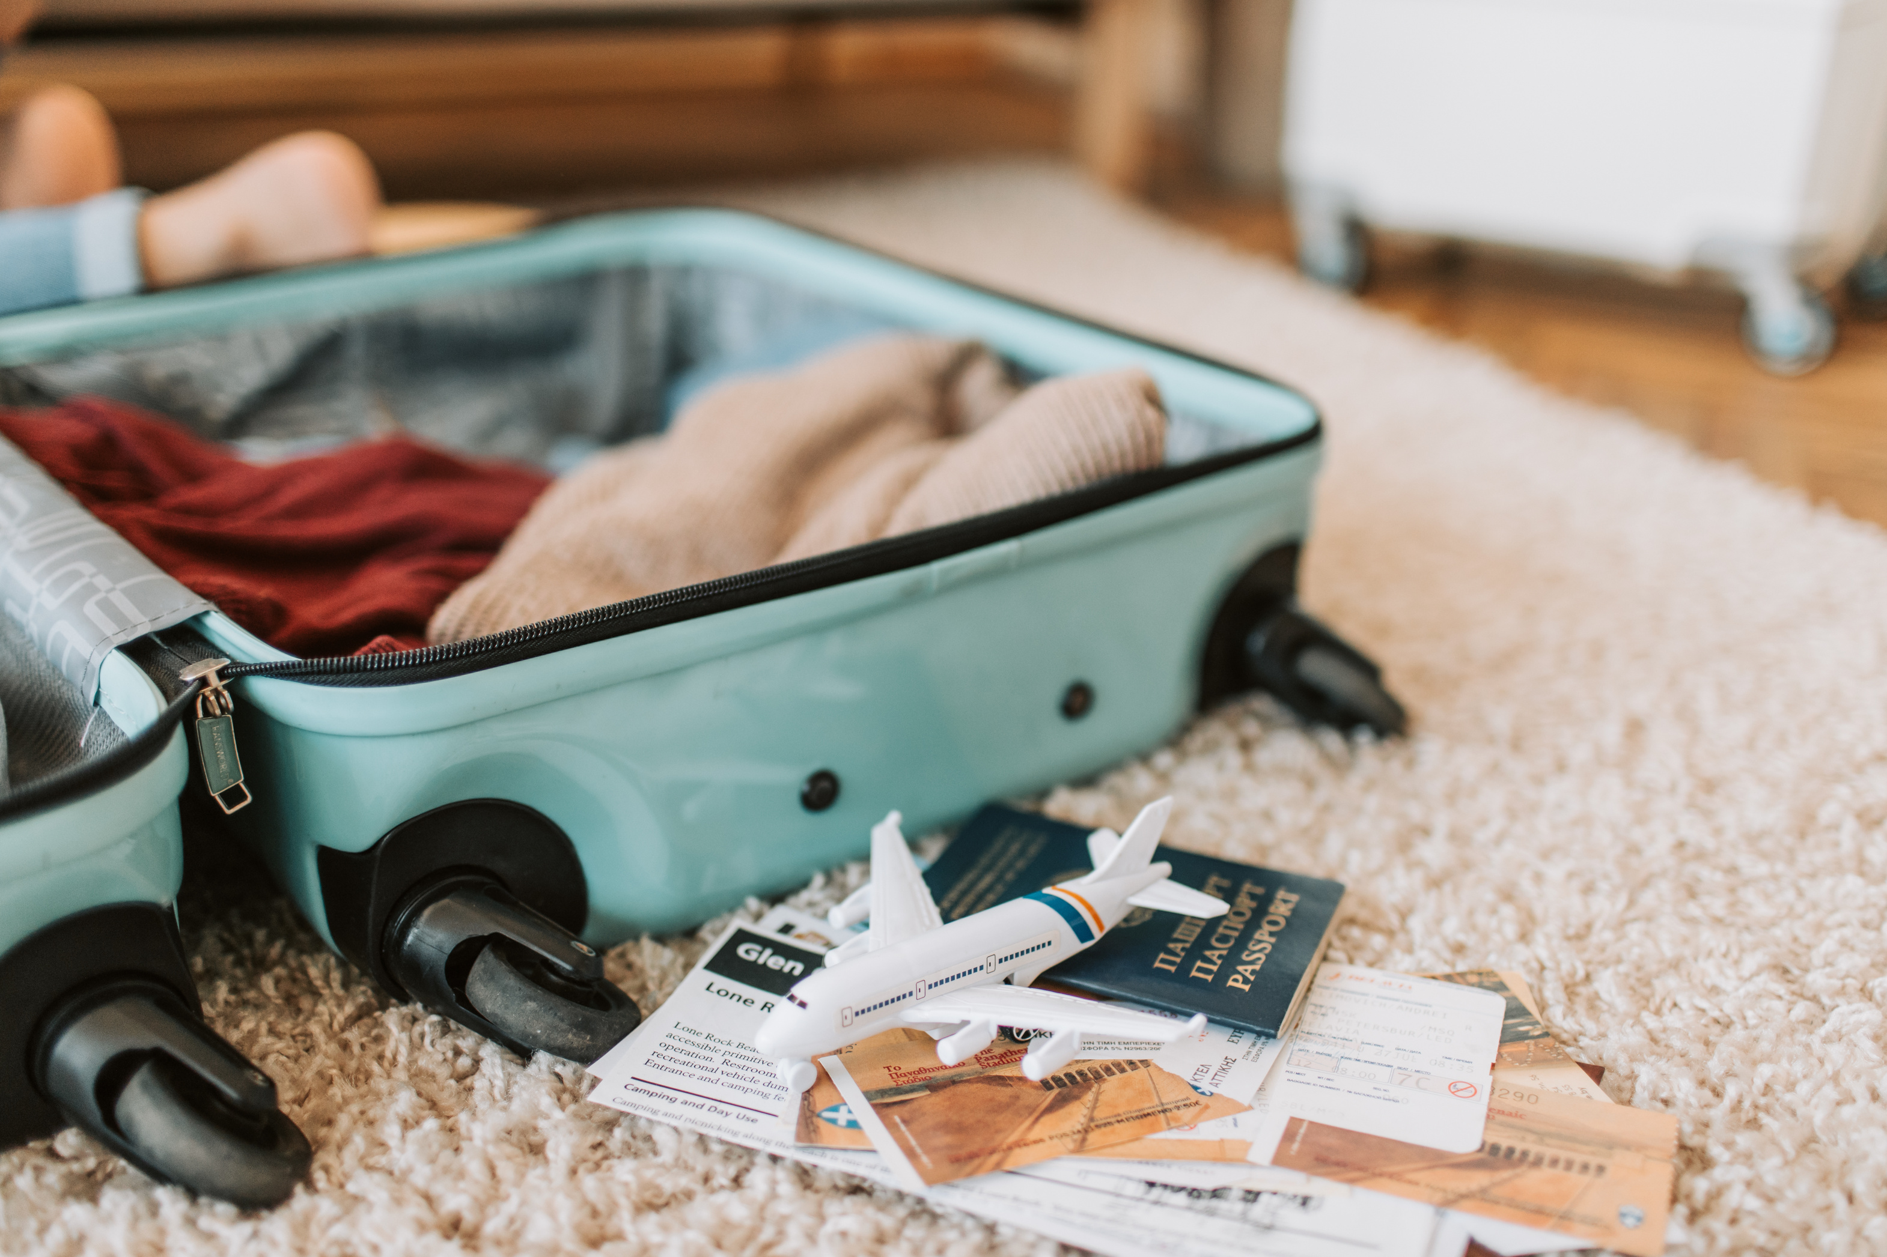


Day 1:
Travel
to Cairo
Welcome to Egypt!
  Arrival: Meet your guide upon arrival in Cairo.
  Hotel Transfer: Check-in, enjoy dinner, and relax.

Slide 3
  Capital of Egypt:
Largest city in the country and one of the most populous in the Middle East and Africa.
  Location:
Eastern bank of the Nile River in northeastern Egypt.
  Nickname:
"City of a Thousand Minarets" due to its numerous historic Islamic mosques and monuments.
  Blend of Cultures:
Islamic culture, ancient history, and modern urban life.
  Historical Significance:
Established in the 10th century AD by the Fatimids, named Al-Qahira ("The Victorious").
Introduction

Slide 4
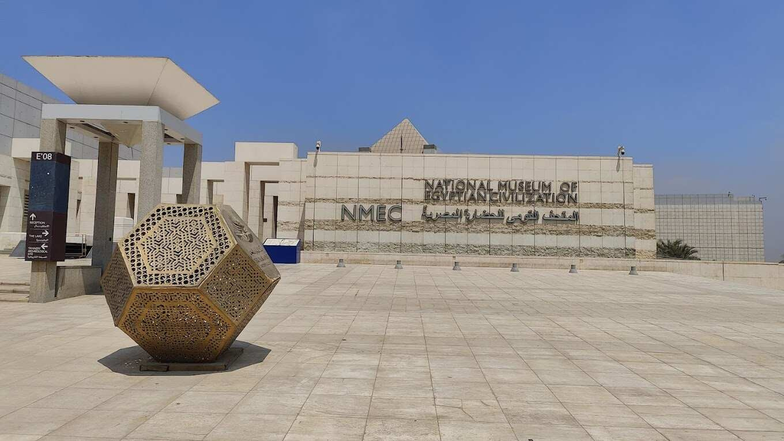
Morning:
After breakfast, meet your guide and start your journey through Cairo.
National Museum of Egyptian Civilization (NMEC)
    Opened in 2017: Showcases Egypt’s rich heritage from prehistoric times to the modern era.
    Exhibits:
      Chronology Section: Timeline of Egypt’s history.
      Thematic Section: Highlights aspects of Egyptian civilizations.
      Royal Mummies Gallery: Features 22 mummies of ancient Egyptian monarchs.
Day 2: Exploring Cairo

Slide 5
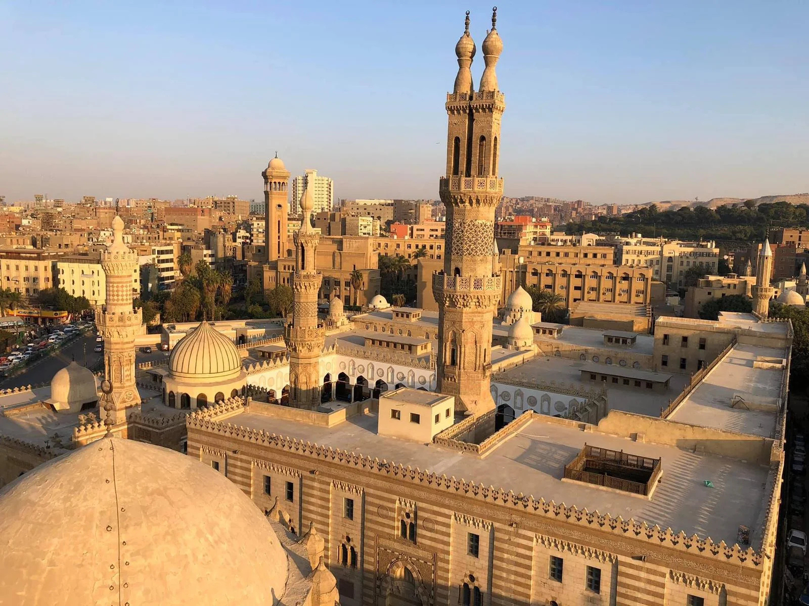
Old Cairo:
  Historic Sites:
    Al-Azhar Mosque: One of the oldest and most significant Islamic mosques and universities.
    Mosque of Sultan Hassan: Famous for its massive architecture.
    Mosque of Ibn Tulun: Oldest surviving mosque in Cairo.
    The Hanging Church: One of the oldest Christian churches in Egypt.
Day 2: Exploring Cairo

Slide 6
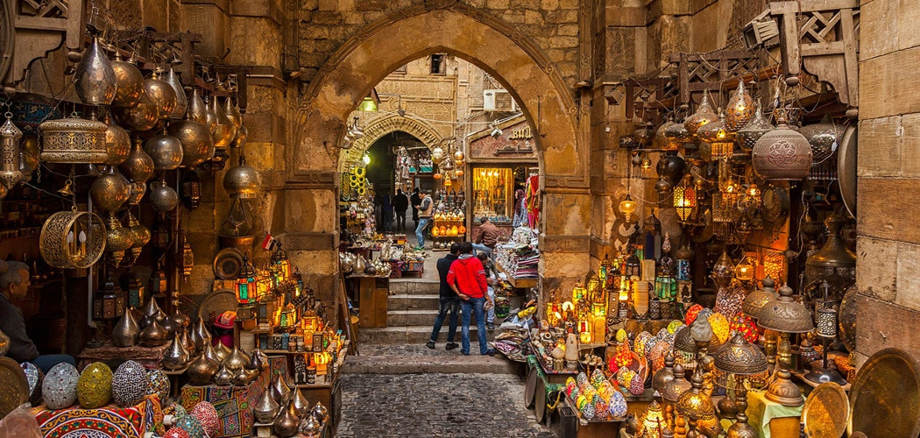
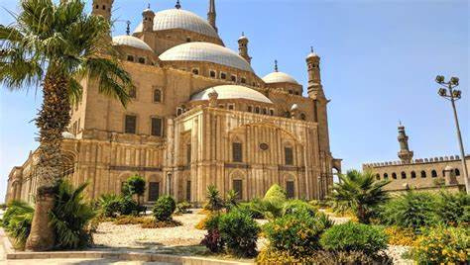
Day 2: Exploring Cairo
  Citadel of Salah El-Din: Medieval Fortress: Built to defend against Crusaders.
    Mosque of Muhammad Ali: 19th-century Ottoman-style mosque.
    An-Nasir Muhammad Mosque: Notable for its unique minarets.
    Khan El-Khalili Bazaar:Historic Market, established in the 14th century.
    Shopping: Jewelry, spices, textiles, lamps, and souvenirs.
Evening:
Return to the hotel for dinner and free time.

Slide 7
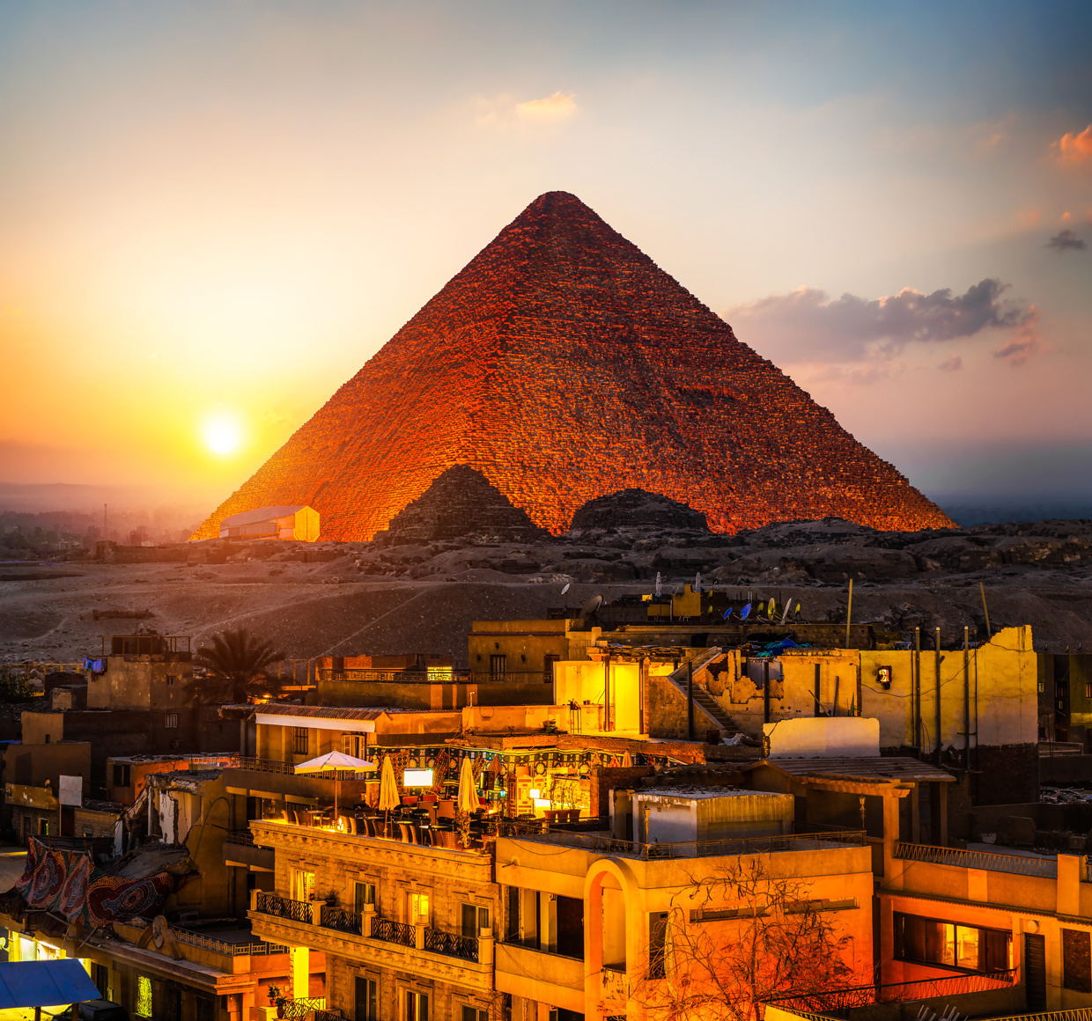
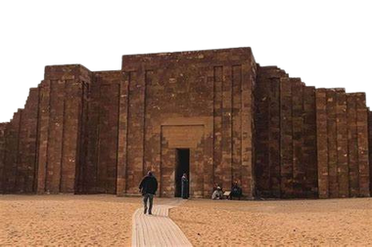
Morning:
  After breakfast, meet your guide and explore the Giza Plateau and Saqqara necropolis.
Pyramids of Giza:
  Great Pyramid of Khufu: Largest of the three pyramids, built around 2570 BC.
  Pyramid of Khafre: Notable for its well-preserved limestone casing at the top.
  Pyramid of Menkaure: Smallest of the three pyramids, originally covered in red granite.
  Great Sphinx: Colossal statue of a lion with a human head.
  Saqqara:
  Step Pyramid of Djoser: First stone pyramid in history, designed by Imhotep.
  Pyramid of Teti: Known for its Pyramid Texts.
  Mastabas: Lavish tombs of high officials with intricate reliefs.
Evening:
  Return to the hotel for dinner and relaxation.
Day 3:
The Giza
and Saqqara Pyramids

Slide 8
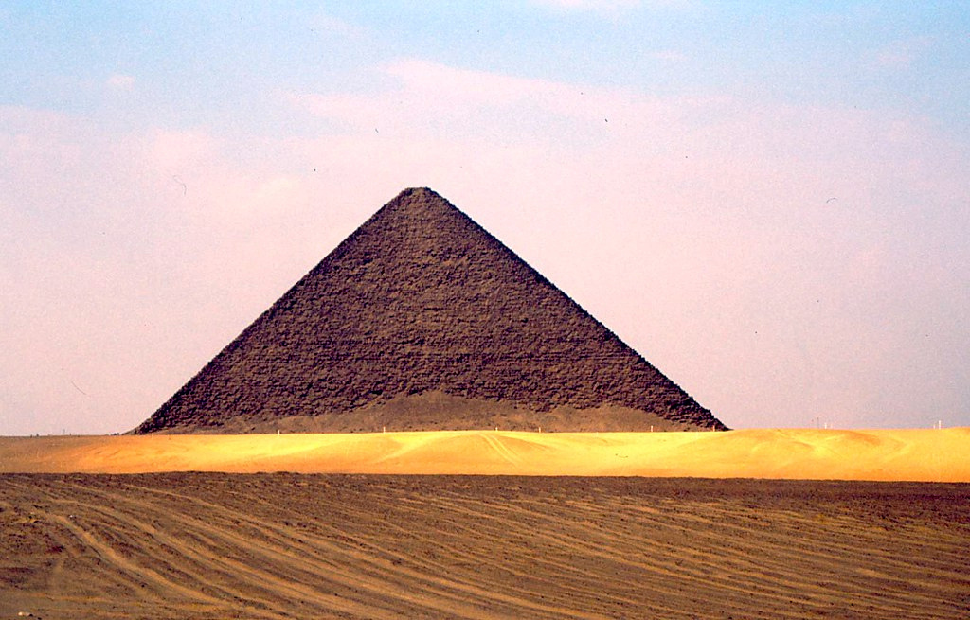
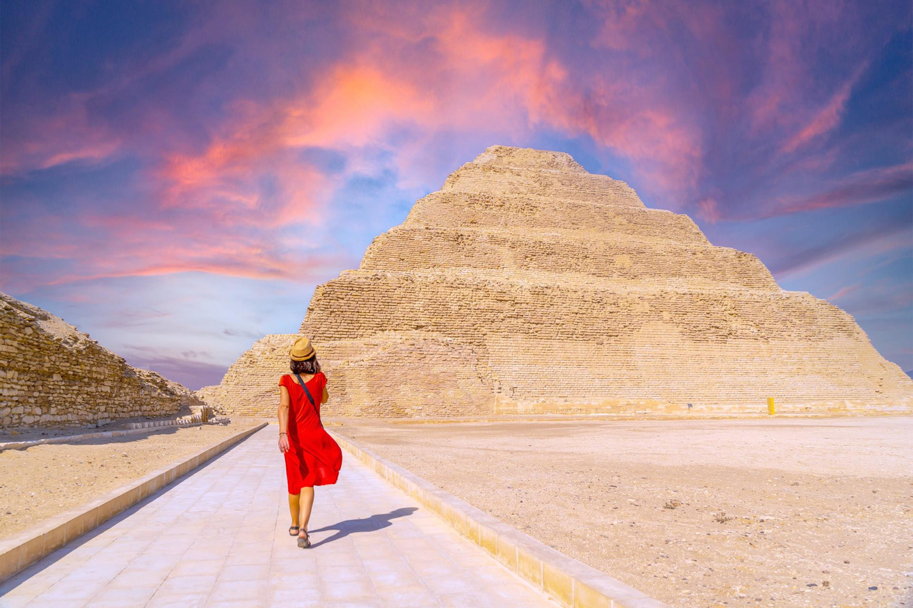
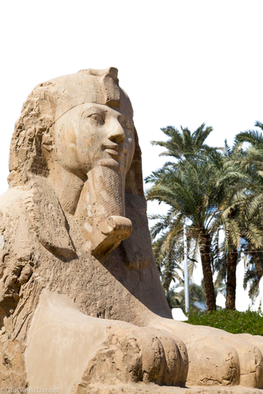
Morning:
After breakfast, meet your guide and explore Memphis and Dahshur.
Memphis:
  Ancient Capital: Founded around 3100 BC by Pharaoh Narmer.
    Key Attractions:
      Colossal Statue of Ramesses II: 10-meter-tall masterpiece.
      Alabaster Sphinx: 4-meter-high statue carved from a single piece of alabaster.
Dahshur:
  Bent Pyramid: Distinctive shape due to a change in angle during construction.
  Red Pyramid: First true smooth-sided pyramid.
  Black Pyramid: Built during the Middle Kingdom, now collapsed but significant.
Evening:
Transfer to the airport for departure from Cairo.
Day 4:
Memphis
and Dahshur

