Slide 1
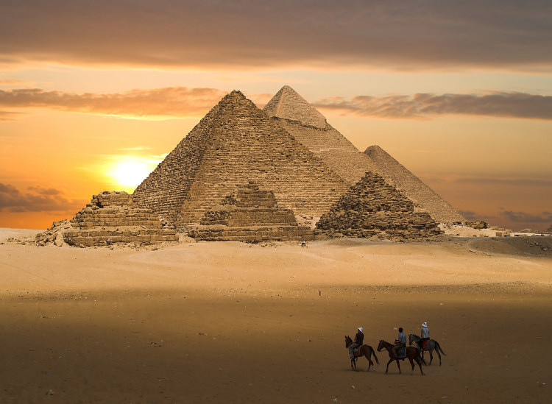
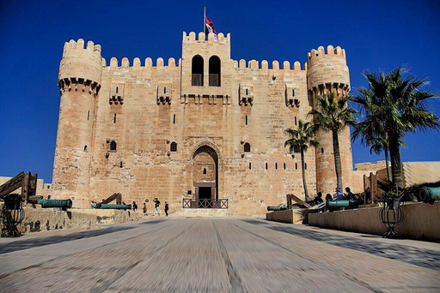
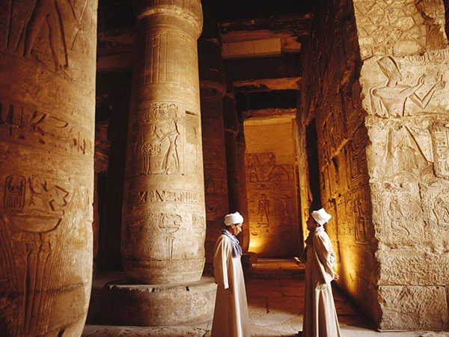



Explore the Timeless Wonders of:
Egypt
February 2025
THE COUNTRY OF PYRAMIDS AND PHARAOHS

Slide 2
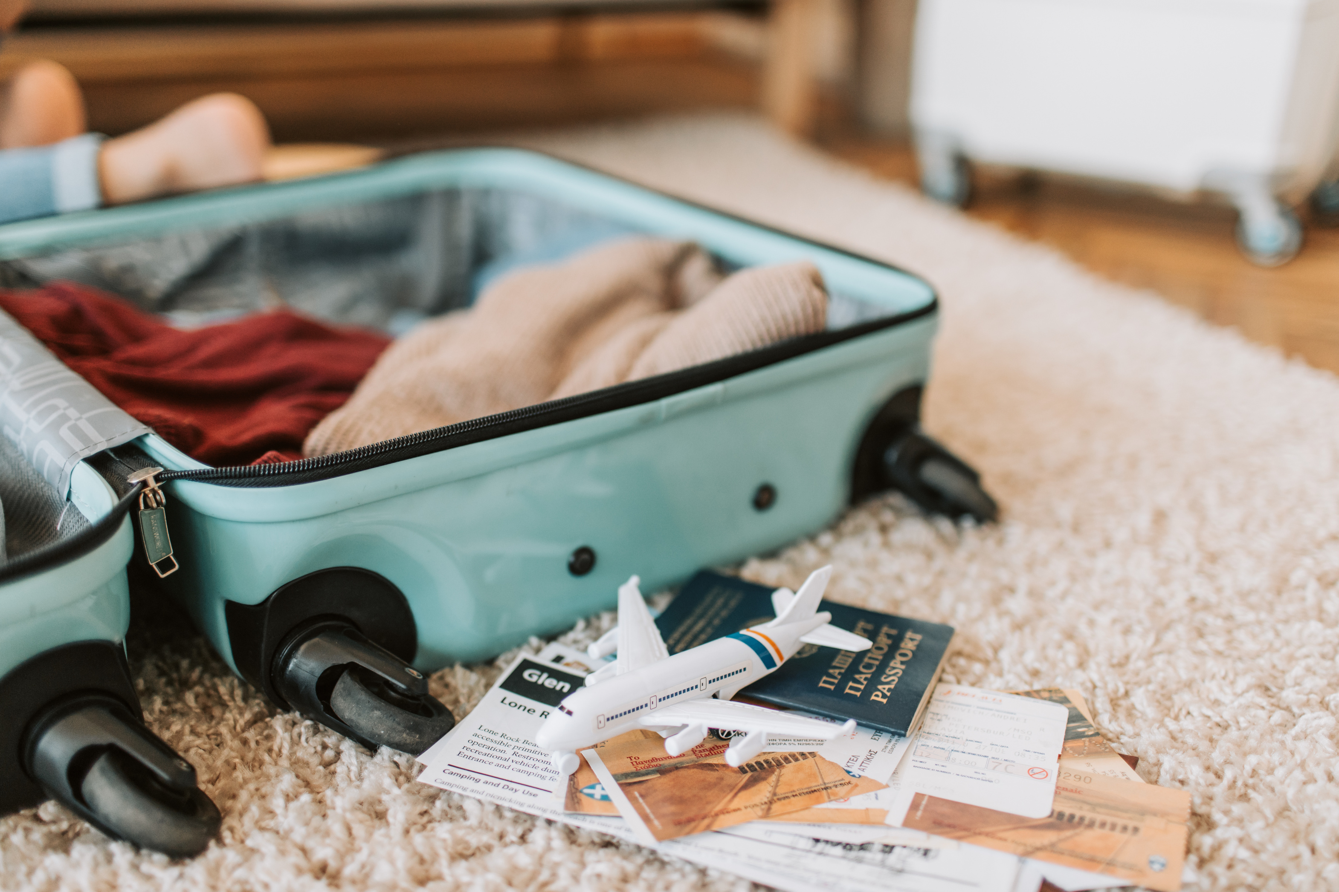


Day 1:
Arrival in Hurghada
Welcome to Egypt!
  Arrival:
Touch down in Hurghada.
  Hotel Transfer:
Smooth check-in and time to unwind.
  Relax:
Enjoy the hotel amenities and start your adventure.

Slide 3
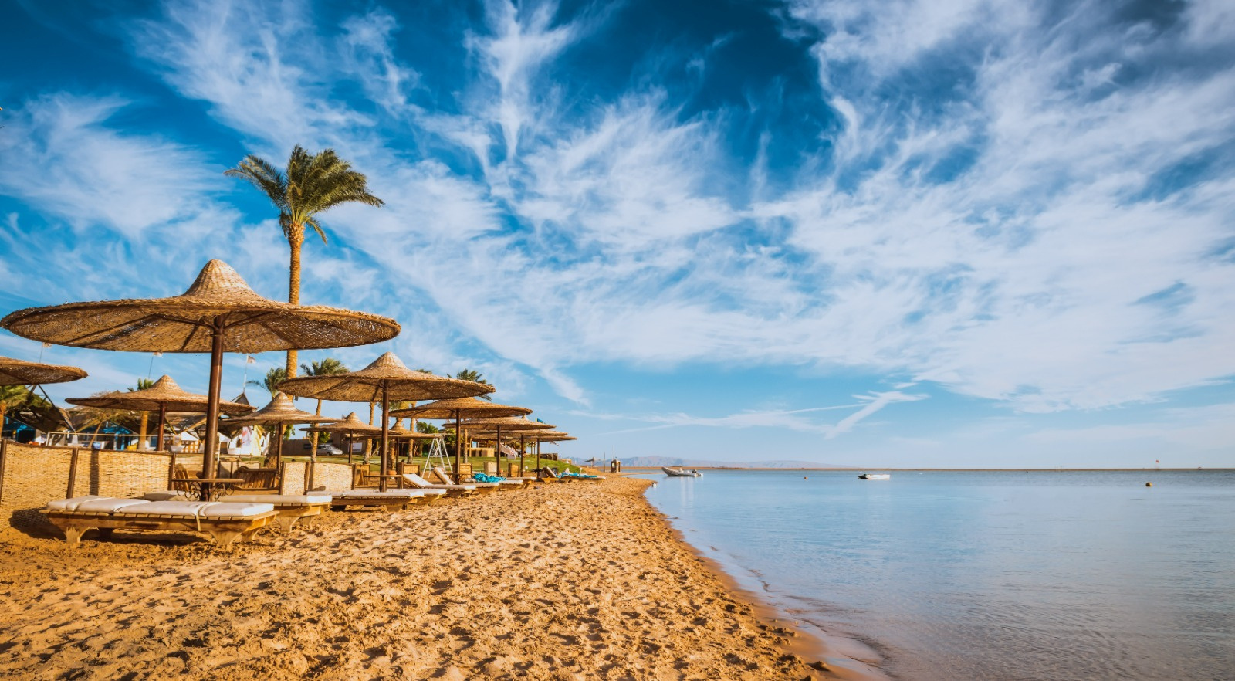
Day 2: Hurghada
Discover Hurghada!
  Explore:
Wander through the vibrant streets or relax by the Red Sea.
  Tour Briefing: Meet with our representative for an exciting overview of your journey.

Slide 4
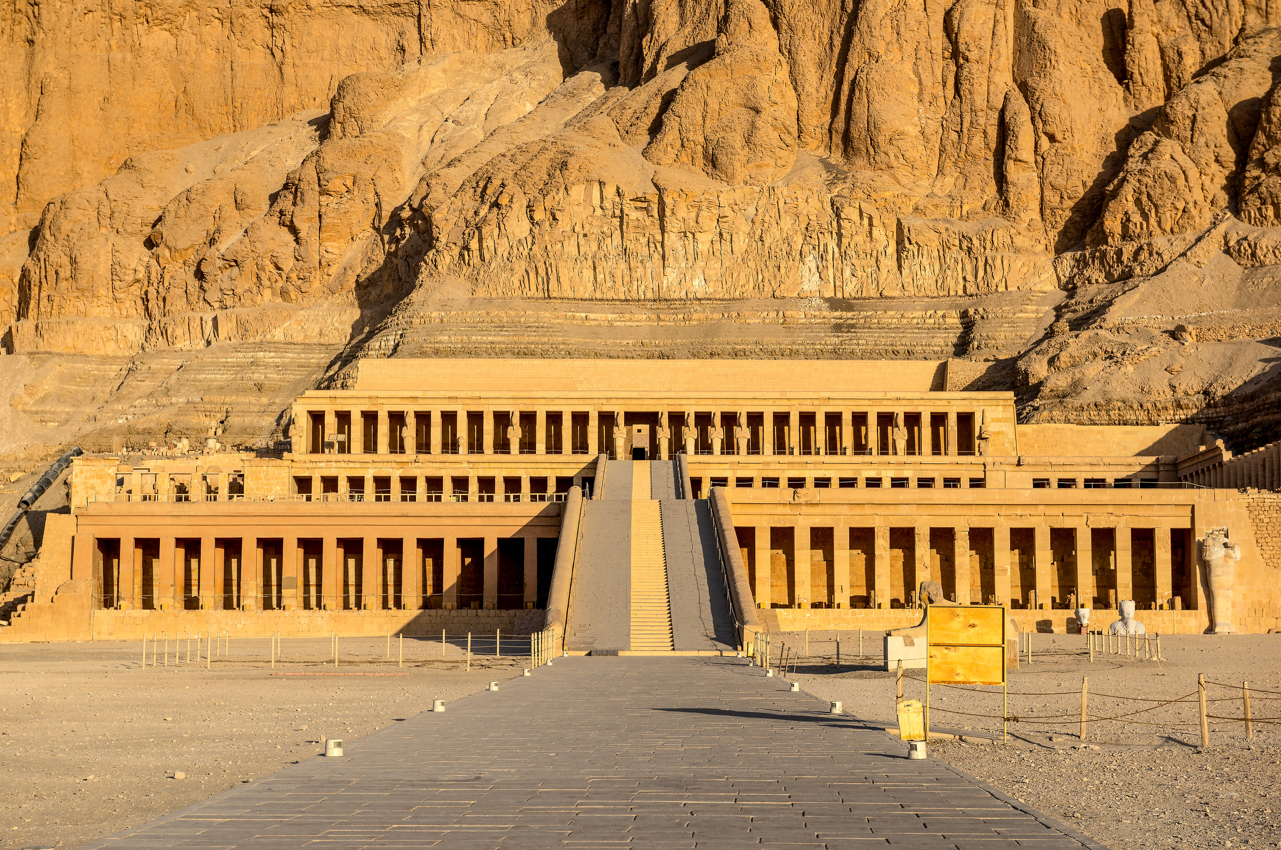



Afternoon:
  Karnak Temple:
Explore the largest temple complex in Egypt.
  Luxor Temple:
Discover the majestic sanctuary dating back to 1400 BC.
Evening:
  Nile Cruise:
Experience a scenic cruise on a traditional Egyptian felucca.
  Dinner and Overnight:
Stay in Luxor.
Morning:
    Early Morning Departure; set off for Luxor (approx. 4 hours).
Luxor Highlights:
  Colossi of Memnon:
Stand in awe of these massive statues of Pharaoh Amenhotep III.
  Valley of the Kings:
Step into history with a visit to ancient tombs, including Tutankhamun’s.
  Hatshepsut Temple:
Marvel at the grandeur of Queen Hatshepsut’s mortuary temple.
Day 3:
Luxor Tour

Slide 5
Morning:
  Early Morning Departure:
Head to Dendera.
Dendera Highlights:
  Temple of Hathor:
Admire one of Egypt’s best-preserved temples with its stunning artwork and astronomical significance.
Afternoon:
Abydos Highlights:
  Explore ancient temples and royal cemeteries, including the grand Temple of Seti I.
Evening:
  Return to Hurghada (approx. 3 hours) for an overnight stay.
Day 4:
Dendera
and Abydos

Slide 6
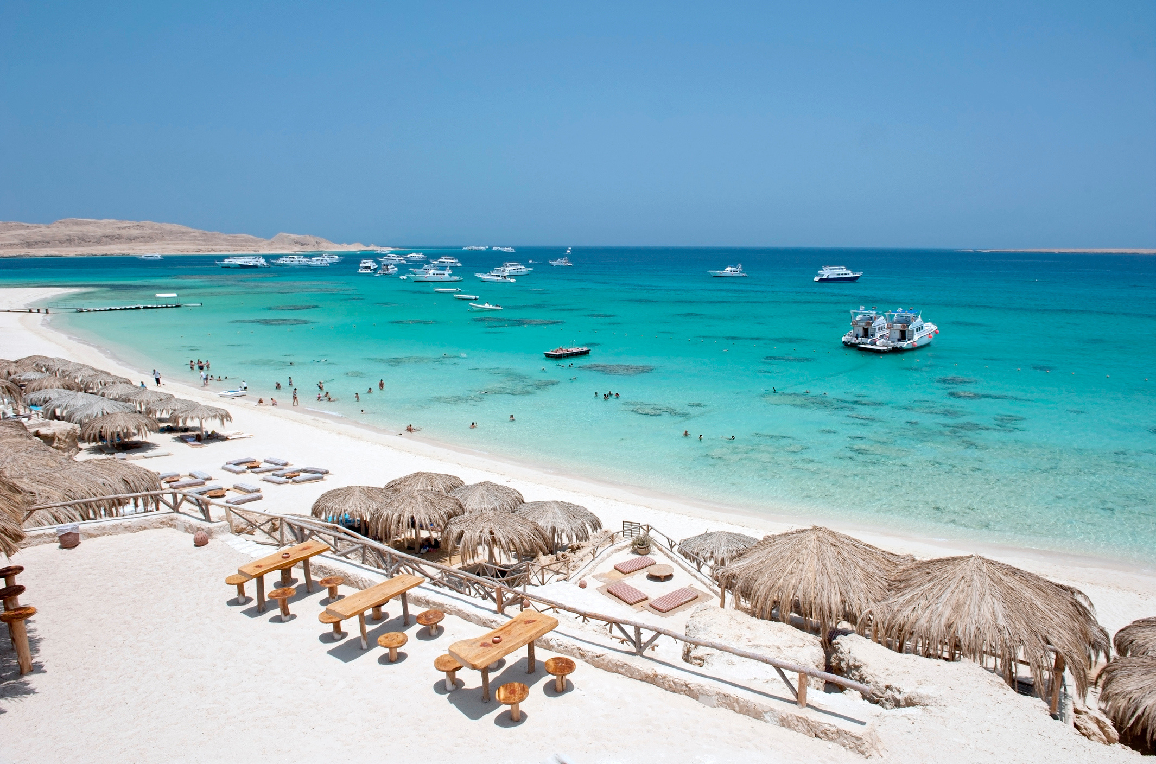
Day 5: Hurghada
Relax and Enjoy!
Dive into the Red Sea, sunbathe, or explore local attractions.

Slide 7
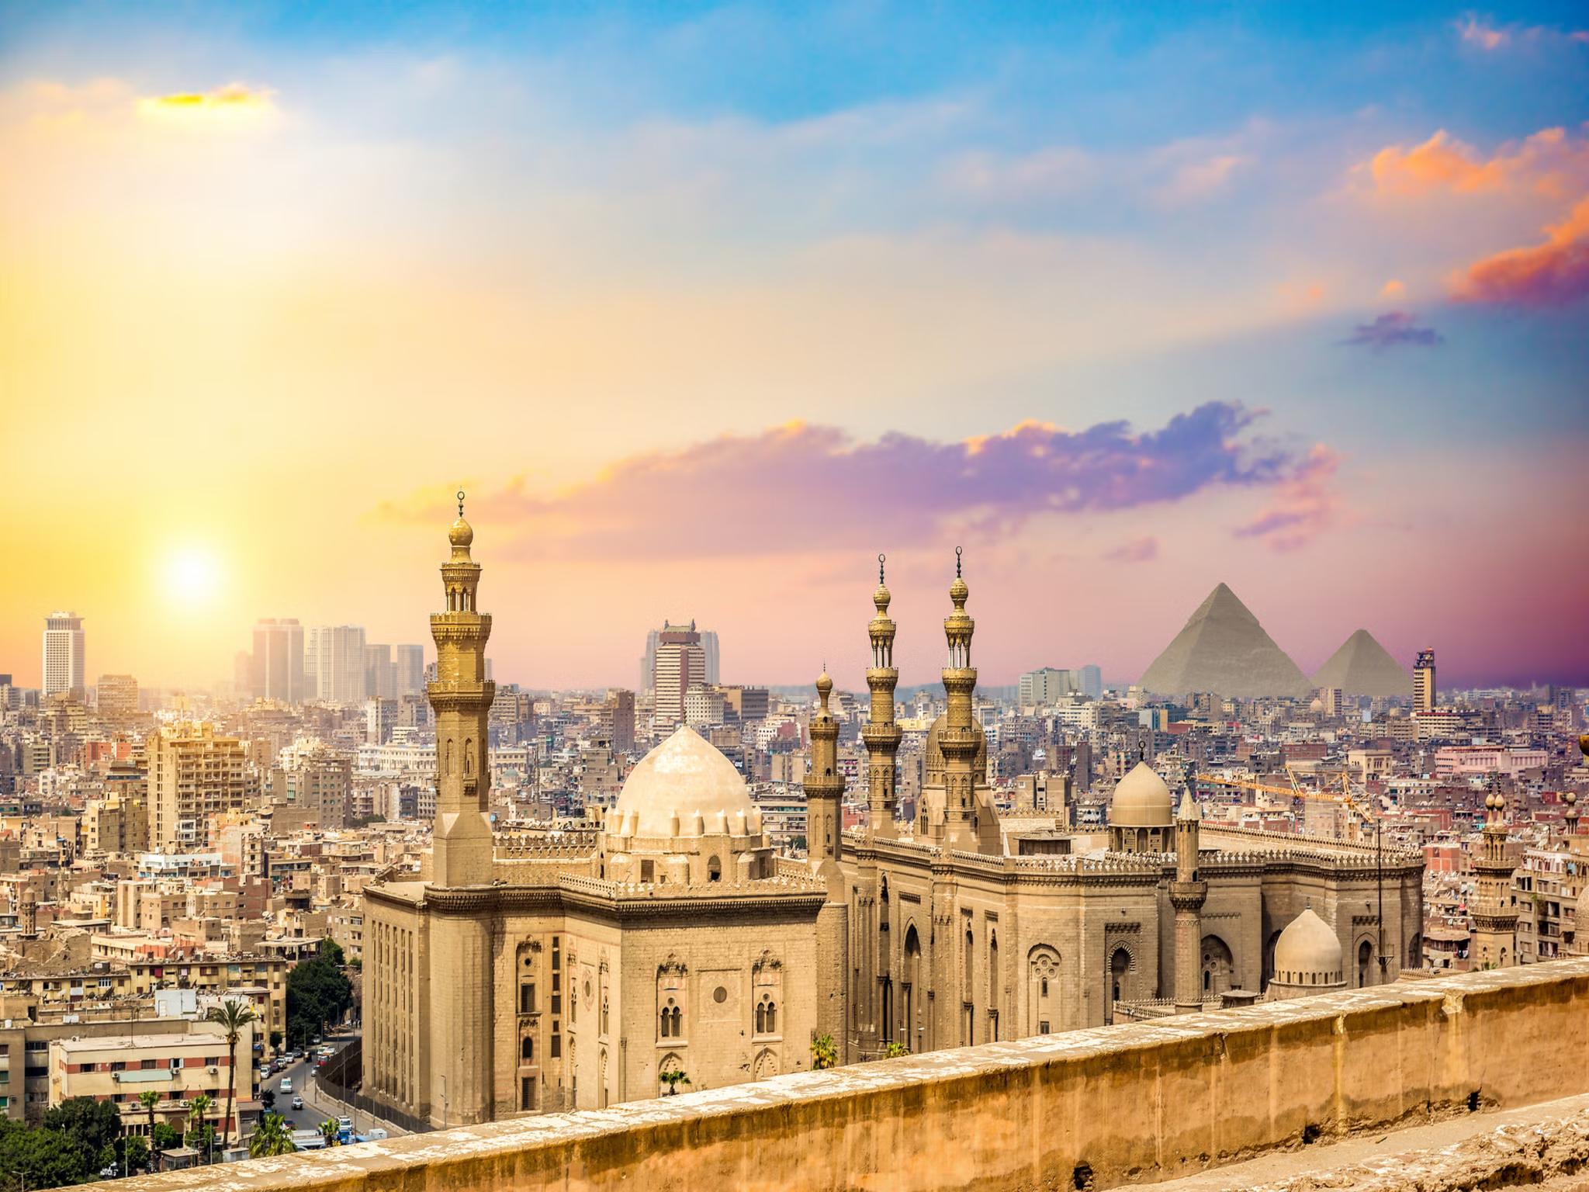
Morning:
  Early Morning Departure:
Journey to Cairo (approx. 6 hours).
Cairo Highlights:
  Coptic Church & Mosque:
Discover the rich religious heritage of Cairo.
  Grand Egyptian Museum:
View 10,000 artifacts, including treasures of Tutankhamun.
  Pyramids of Giza:
Visit the iconic pyramids and the Great Sphinx.
  Cheops Pyramid:
Marvel at the world’s largest pyramid (entry optional).
Hurghada.
Evening:
  Return to Hurghada for an overnight stay.
Day 6:
Cairo

Slide 8
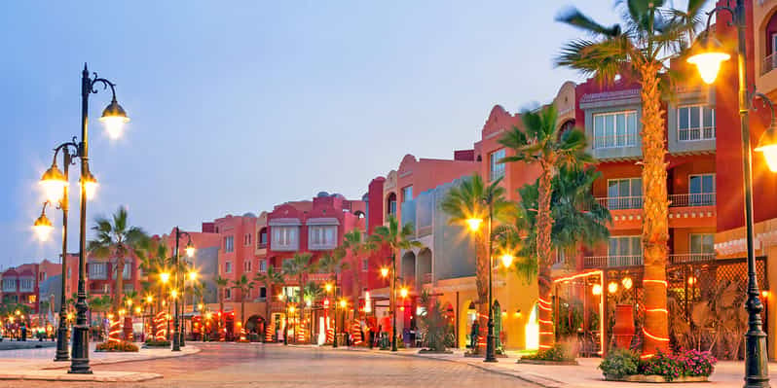
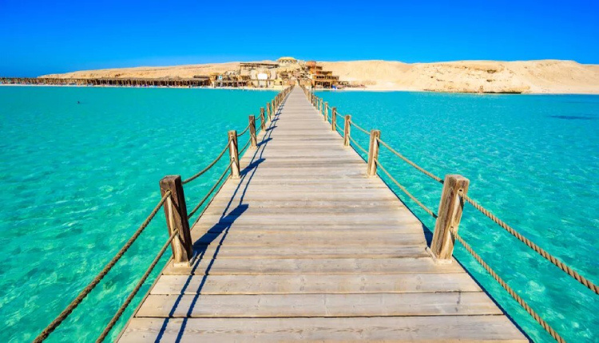
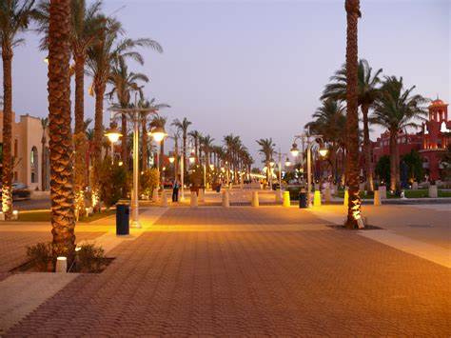
Day 7: Hurghada
Relax and Enjoy!
Make the most of your last day in Hurghada.

Slide 9

Day 8: Departure
Hotel Check-out & Transfer to the airport and depart from Hurghada.

Slide 10
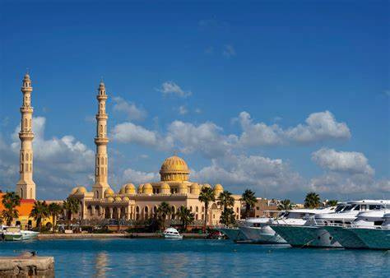


Inclusions
  Guided Tours:
With admission to monuments.
  Accommodation & Meals:
As per itinerary (drinks excluded).
  Transfers:
Between cities and attractions.

