Slide 1
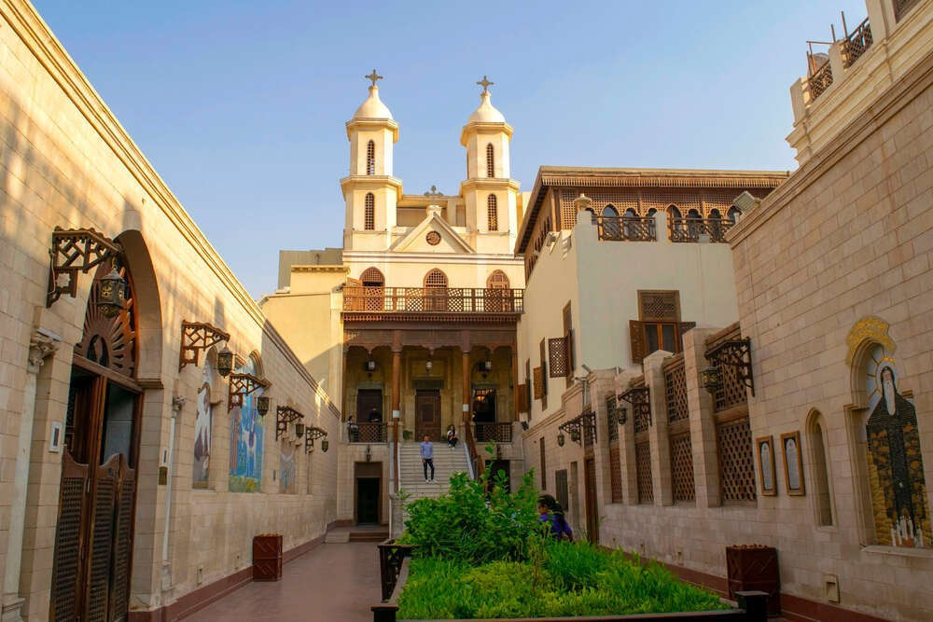
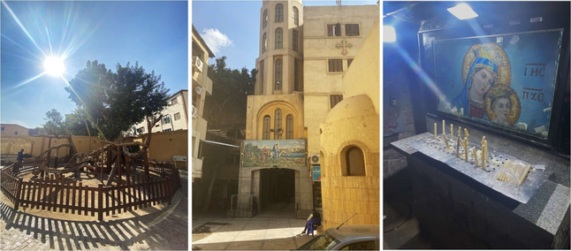
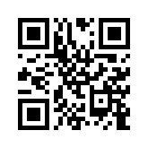




Following the Footsteps
of the Holy Family
February 2025
"CITY OF A THOUSAND MINARETS"

Slide 2
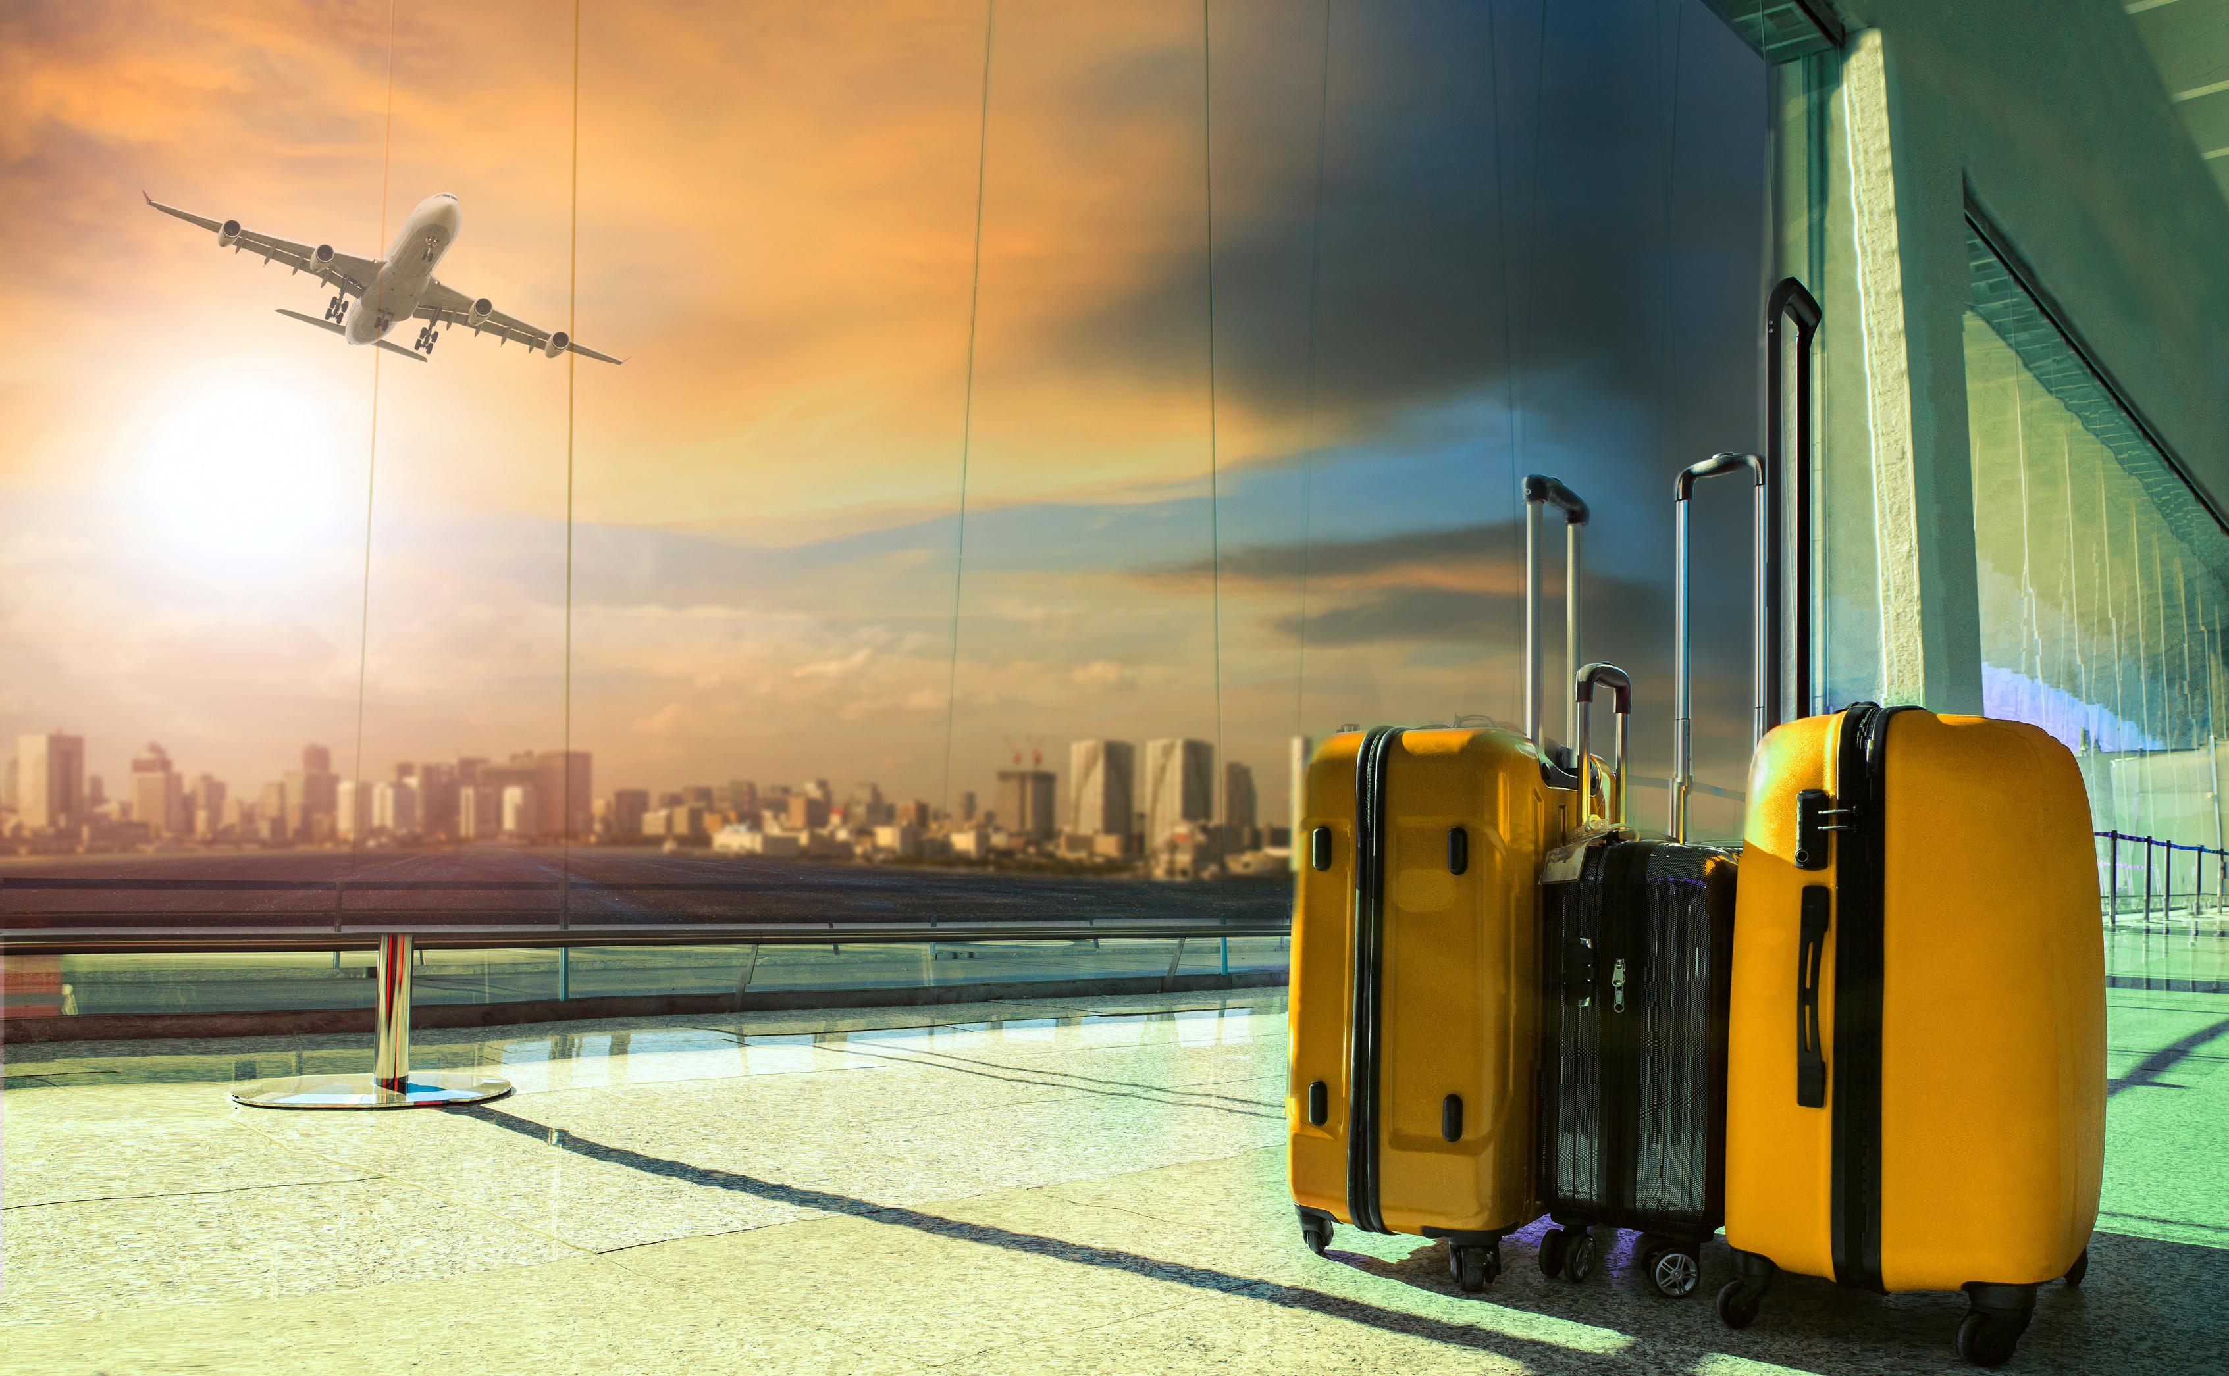


Day 1:
Departure
and Arrival
Welcome to Egypt!
  Departure: From domestic airport.
  Arrival to Hurghada:Welcome and assistance with visa processing.
  Transfer to Cairo: Evening arrival, hotel check-in, and free time to rest.

Slide 3
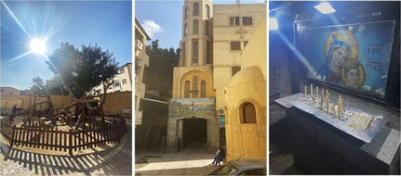
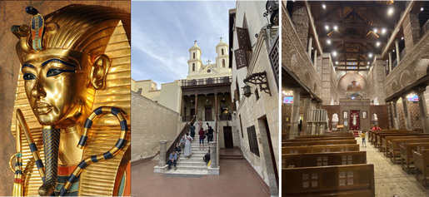

Day 2: Exploring Cairo's Holy Sites
Morning:
  El Mataria District: Visit the ancient plane tree of St. Virgin Mary.
  Mostorod District: Church of St. Virgin Mary, where a spring miraculously appeared.
Afternoon:
  National Egyptian Museum: Discover Egypt's rich history.
Lunch: Enjoy traditional Egyptian specialties.
  Coptic Quarter: Tour the historic center.
  Hanging Church: The oldest church in the district.
  Church of St. Sergius and Bacchus: Built over the cave where the Holy Family stayed.
  Roman Fortress of Babylon: Well-preserved ancient fortress.
  Church of St. George: Large and beautiful church nearby.
Evening:
  Saladin's Citadel: Impressive medieval fortress.
  Khan El-Khalili Bazaar: Dive into the vibrant market for authentic Egyptian handicrafts.

Slide 4
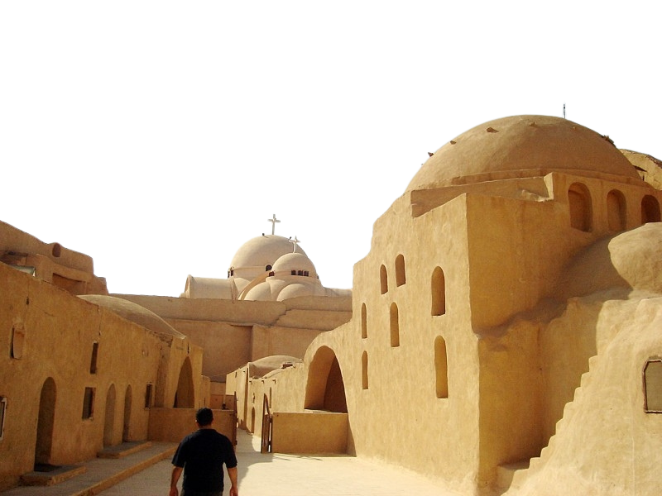
Morning:
  Wadi El-Natrun (by Bus): Visit the desert valley, a temporary home of the Holy Family.
    Monasteries:
      Monastery of St. Bishoy
      Monastery of Paramos
      Monastery of Our Lady of the Syrians
      Monastery of St. Macarius (if open to the public).
Afternoon:
    Return to Cairo: Free time and relaxation at the hotel.
Day 3:
Wadi El-Natrun Monasteries

Slide 5
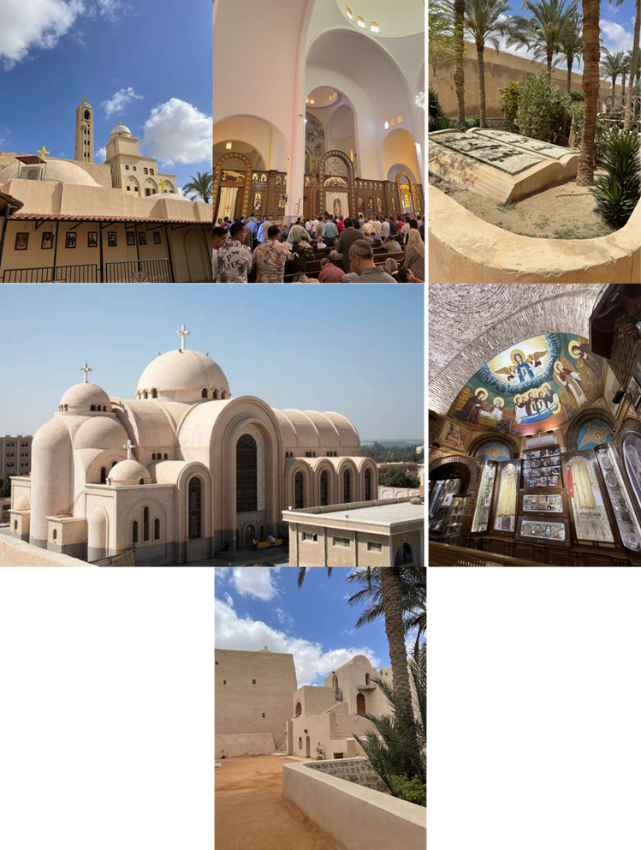
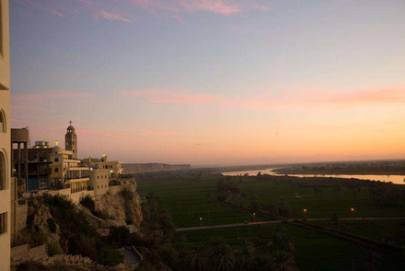
Morning:
  Garbage City: Visit the neighborhood and the church of St. Simon the Garbageman.
  Church of St. Mark: Located in a cave below St. Simon's church.
Afternoon:
  Church of St. Mary in Maadi: The oldest church in Egypt, site of a miraculous event.
  Pyramids of Giza: Visit the iconic pyramids and the Great Sphinx.
  Camel or Horse Ride: Optional activity at the pyramids.
Evening:
  Journey to Minya Region: Arrive at Gabal al-Tayr, stay at The Holy Family Hotel with stunning views.
Day 4:
Cairo's Hidden Gems

Slide 6
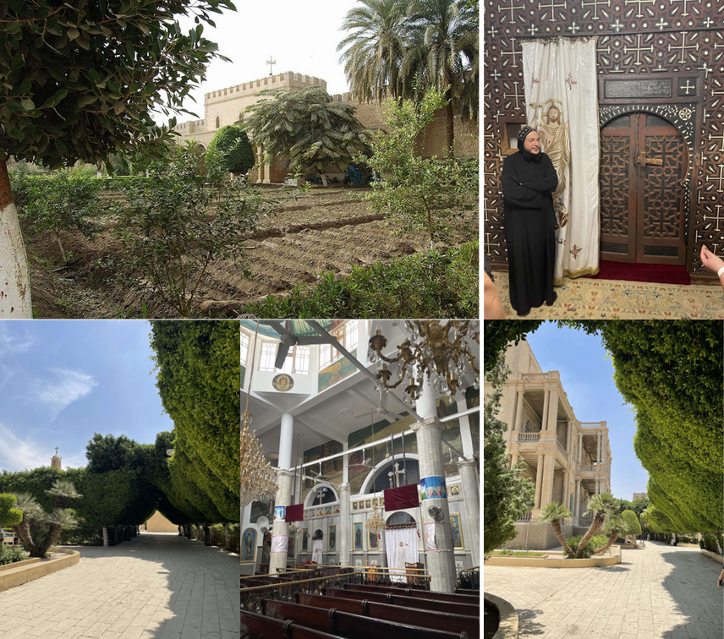
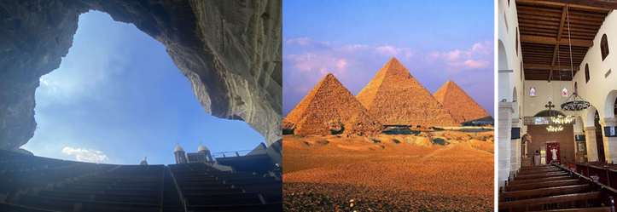
Day 5:
Minya's Sacred Sites
Morning:
  Church and Monastery of the Holy Virgin: See the alleged imprint of Christ's hand.
Afternoon:
  El Muharraq Monastery: Guided tour by a local Coptic monk.
Evening:
  Travel to Assiut: Hotel check-in and relaxation.

Slide 7
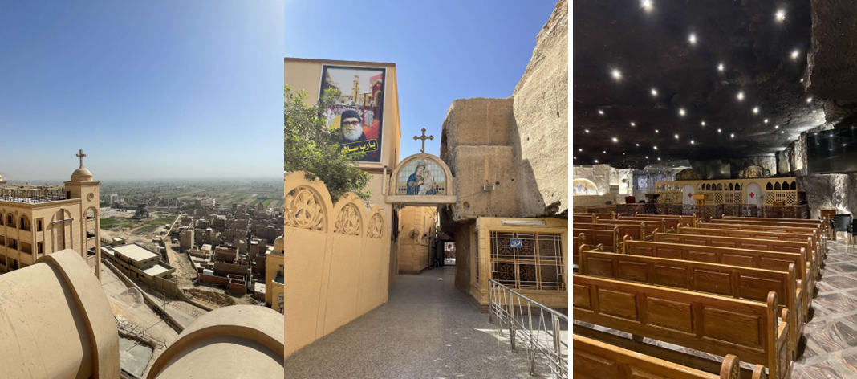
Morning:
  Durunka Monastery:
Explore the extensive area and learn about its history.
Take in the stunning views, enjoy some refreshments, and then commence our return journey to Hurghada.
Afternoon:
  Return to Hurghada: Arrive at the hotel in the evening.
Day 6:
Durunka Monastery

Slide 8

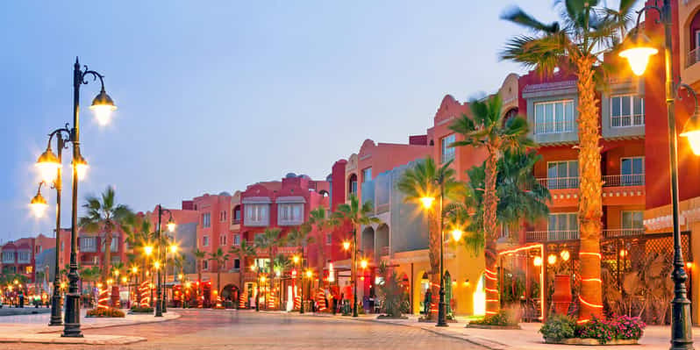
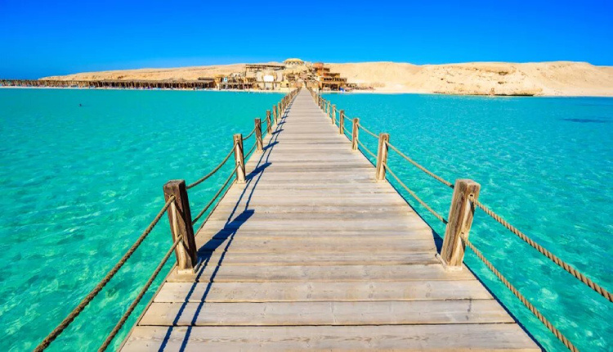
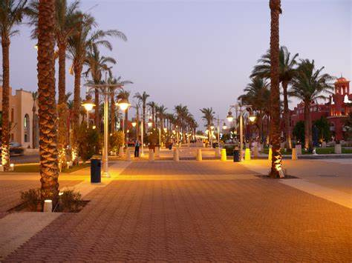
Day 7:
Hurghada
Relax and Enjoy!
Make the most of your last day in Hurghada.
(Enjoy the beach resort, go shopping, or take a walk around the city).

Slide 9
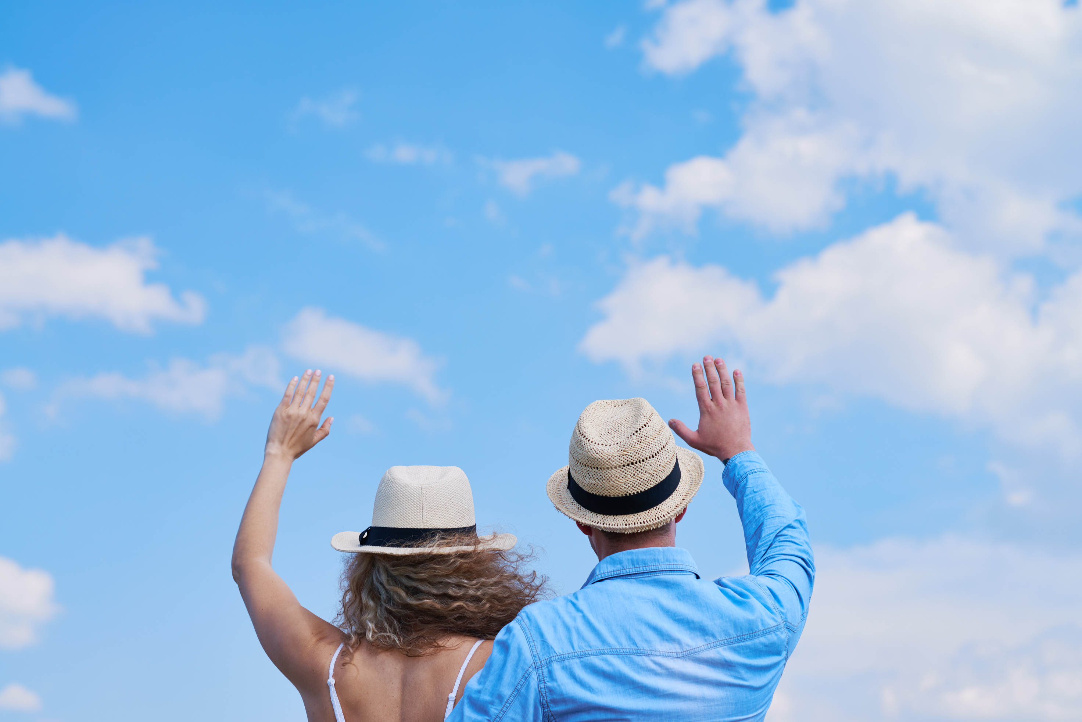
Day 8: Departure
Hotel Check-out & Transfer to the airport and depart from Hurghada.

